Slide 1
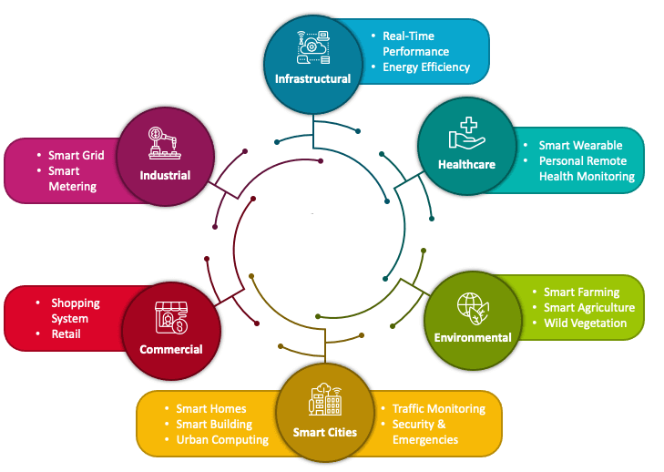

Two stage transistor amplifiers
PDS
https://www.youtube.com/@AmelOline
https://github.com/amelcharolinesgn2/DE/upload

Slide 2
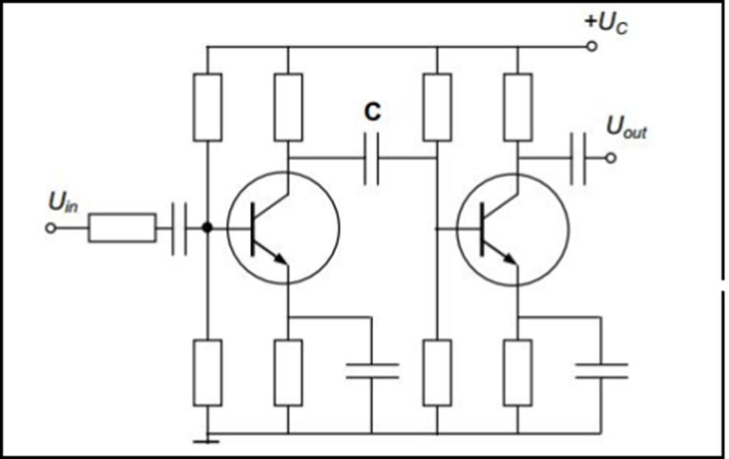

Two-stage transistor amplifiers
The following figure shows a two-stage amplifier connected in cascade.

Slide 3
The overall gain is the product of voltage gain of individual stages.
AV=AV1×AV2
V2/V1×V0/V2=V0/V1
Where A_{V} = Overall gain, A_{V1} = Voltage gain of 1st stage, and A_{V2} = Voltage gain of 2nd stage.
If there are n numbers of stages, the product of voltage gains of those n stages will be the overall gain of that multistage amplifier circuit.

Slide 4
Amplifier Consideration
For an amplifier circuit, the overall gain of the amplifier is an important consideration. To achieve maximum voltage gain, let us find the most suitable transistor configuration for cascading.
CC Amplifier
Its voltage gain is less than unity.
It is not suitable for intermediate stages.
CB Amplifier
Its voltage gain is less than unity.
Hence not suitable for cascading.

Slide 5
CE Amplifier
Its voltage gain is greater than unity.
Voltage gain is further increased by cascading.
The characteristics of CE amplifier are such that, this configuration is very suitable for cascading in amplifier circuits. Hence most of the amplifier circuits use CE configuration.

Slide 6
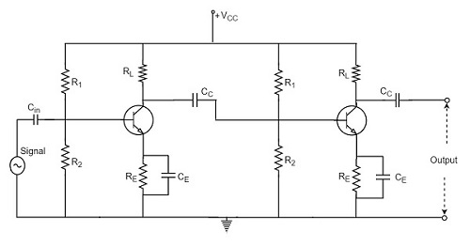
RC Coupling Amplifier
The resistance-capacitance coupling is, in short termed as RC coupling. This is the mostly used coupling technique in amplifiers.

Slide 7
Construction of a Two-stage RC Coupled Amplifier
The constructional details of a two-stage RC coupled transistor amplifier circuit are as follows.
The two stage amplifier circuit has two transistors, connected in CE configuration and a common power supply V_{CC} is used.
The potential divider network R₁ and R₂ and the resistor R_{e} form the biasing and stabilization network.
The emitter by-pass capacitor C_{e} offers a low reactance path to the signal.

Slide 8
The resistor R_{L} is used as a load impedance. The input capacitor C_{in} present at the initial stage of the amplifier couples AC signal to the base of the transistor. The capacitor C_{C} is the coupling capacitor that connects two stages and prevents DC interference between the stages and controls the shift of operating point.

Slide 9
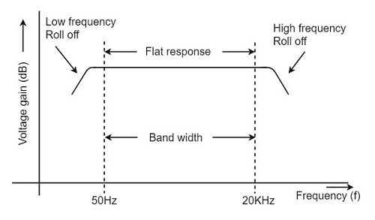
Frequency Response of RC Coupled Amplifier
Frequency response curve is a graph that indicates the relationship between voltage gain and function of frequency. The frequency response of a RC coupled amplifier is as shown in the following graph.
From the graph, it is understood that the frequency rolls off or decreases for the frequencies below 50Hz and for the frequencies above 20 KHz. whereas the voltage gain for the range of frequencies between 50Hz and 20 KHz is constant. Following equation means that the capacitive reactance is inversely proportional to the frequency.
Xc=1/2πfc

Slide 10
At Low frequencies (i.e. below 50 Hz)
The capacitive reactance is inversely proportional to the frequency. At low frequencies, the reactance is quite high. The reactance of input capacitor C_{in} and the coupling capacitor C_{C} are so high that only small part of the input signal is allowed. The reactance of the emitter by pass capacitor C_{E} is also very high during low frequencies. Hence it cannot shunt the emitter resistance effectively. With all these factors, the voltage gain rolls off at low frequencies.

Slide 11
At High frequencies (i.e. above 20 KHz)
Again considering the same point, we know that the capacitive reactance is low at high frequencies. So, a capacitor behaves as a short circuit, at high frequencies. As a result of this, the loading effect of the next stage increases, which reduces the voltage gain. Along with this, as the capacitance of emitter diode decreases, it increases the base current of the transistor due to which the current gain (β) reduces. Hence the voltage gain rolls off at high frequencies.

Slide 12
At Mid-frequencies (i.e. 50 Hz to 20 KHz)
The voltage gain of the capacitors is maintained constant in this range of frequencies, as shown in figure. If the frequency increases, the reactance of the capacitor C_{C} decreases which tends to increase the gain. But this lower capacitance reactive increases the loading effect of the next stage by which there is a reduction in gain.
Due to these two factors, the gain is maintained constant.

Slide 13
Advantages of RC Coupled Amplifier
The following are the advantages of RC coupled amplifier.
The frequency response of RC amplifier provides constant gain over a wide frequency range, hence most suitable for audio applications.
The circuit is simple and has lower cost because it employs resistors and capacitors which are cheap.
It becomes more compact with the upgrading technology.

Slide 14
Disadvantages of RC Coupled Amplifier
The following are the disadvantages of RC coupled amplifier.
The voltage and power gain are low because of the effective load resistance.
They become noisy with age.
Due to poor impedance matching, power transfer will be low

Slide 15
Applications of RC Coupled Amplifier
The following are the applications of RC coupled amplifier.
They have excellent audio fidelity over a wide range of frequency.
Widely used as Voltage amplifiers
Due to poor impedance matching, RC coupling is rarely used in the final stages.

Slide 16
Transformer Coupled Amplifier
We have observed that the main drawback of RC coupled amplifier
is that the effective load resistance gets reduced.
This is because, the input impedance of an amplifier is low, while its output impedance is high.
When they are coupled to make a multistage amplifier,
the high output impedance of one stage comes in parallel with the low input impedance of next stage. Hence, effective load resistance is decreased. This problem can be overcome by a transformer coupled amplifier.
In a transformer-coupled amplifier, the stages of amplifier are coupled using a transformer. Let us go into the constructional and operational details of a transformer coupled amplifier.

Slide 17
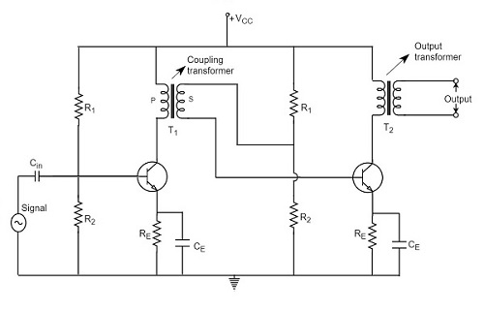
Construction of Transformer Coupled Amplifier
The amplifier circuit in which, the previous stage is connected to the next stage using a coupling transformer, is called as Transformer coupled amplifier.
The potential divider network R₁ and R₂ and the resistor R_{e} together form the biasing and stabilization network.

Slide 18
The emitter by-pass capacitor C_{e} offers a low reactance path to the signal. The resistor R_{L} is used as a load impedance.
The input capacitor C_{in} present at the initial stage of the amplifier couples AC signal to the base of the transistor.
The capacitor C_{C} is the coupling capacitor that connects two stages and prevents DC interference between the stages and controls the shift of operating point.
This transformer coupling provides good impedance matching between the stages of amplifier. The transformer coupled amplifier is generally used for power amplification.

Slide 19
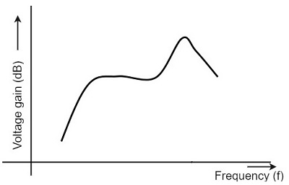
Frequency Response of Transformer Coupled Amplifier
The figure below shows the frequency response of a transformer coupled amplifier. The gain of the amplifier is constant only for a small range of frequencies. The output voltage is equal to the collector current multiplied by the reactance of primary.
At low frequencies, the reactance of primary begins to fall, resulting in decreased gain. At high frequencies, the capacitance between turns of windings acts as a bypass condenser to reduce the output voltage and hence gain.
So, the amplification of audio signals will not be proportionate and some distortion will also get introduced, which is called as Frequency distortion

Slide 20
Advantages of Transformer Coupled Amplifier
.
The following are the advantages of a transformer coupled amplifier −
An excellent impedance matching is provided.
Gain achieved is higher.
There will be no power loss in collector and base resistors.
Efficient in operation.

Slide 21
Disadvantages of Transformer Coupled Amplifier
The following are the disadvantages of a transformer coupled amplifier −
Though the gain is high, it varies considerably with frequency. Hence a poor frequency response.
Frequency distortion is higher.
Transformers tend to produce hum noise.
Transformers are bulky and costly.

Slide 22
Applications
The following are the applications of a transformer coupled amplifier −
Mostly used for impedance matching purposes.
Used for Power amplification.
Used in applications where maximum power transfer is needed.

Slide 23
Direct Coupled Amplifier
As no coupling devices are used, the coupling of the amplifier stages is done directly and hence called as Direct coupled amplifier.
which is especially used to amplify lower frequencies
such as amplifying photo-electric current or thermo-couple current or so.
Construction
The output of first stage transistor T₁ is connected to the input of second stage transistor T₂.

Slide 24
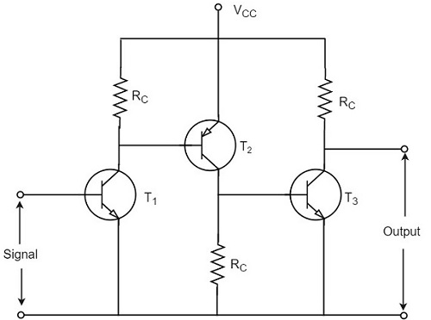
The transistor in the first stage will be an NPN transistor, while the transistor in the next stage will be a PNP transistor and so on. This is because, the variations in one transistor tend to cancel the variations in the other. The rise in the collector current and the variation in β of one transistor gets cancelled by the decrease in the other.

Slide 25
Advantages
The advantages of direct coupled amplifier are as follows.
The circuit arrangement is simple because of minimum use of resistors.
The circuit is of low cost because of the absence of expensive coupling devices.
Disadvantages
The disadvantages of direct coupled amplifier are as follows.
It cannot be used for amplifying high frequencies.
The operating point is shifted due to temperature variations.
Applications
The applications of direct coupled amplifier are as follows.
Low frequency amplifications.
Low current amplifications.

Slide 26
End

Slide 27
RESPON FREKUENSI PENGUAT TRANSISTOR
PDS

Slide 28
Outlines
Pendahuluan
Konsep Respon Frekuensi Penguat
Respon Penguat di sisi frekuensi rendah
Respon Penguat di sisi frekuensi tinggi

Slide 29
Penguatan terhadap frek
Respon sebuah penguat terhadap perubahan frekuensi input-nya dinyatakan: “fungsi penguatan terhadap frek. masukan penguat”
Akibatnya ? output penguatan penguat mengalami perubahan.
Perubahan penguatan akibat dari perubahan frekuensi input-nya disebut: “tanggapan frekuensi penguat”

Slide 30
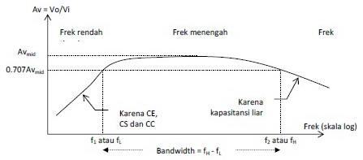

Slide 31
Penguatan Vs Frekuensi
Penguatan maksimum selalu terjadi pada daerah “frekuensi tengah”.
Pada frekuensi bawah, cenderung penguatan akan semakin bertambah, disebabkan: “faktor reaktansi kapasitif yang besar dari penguat”.
pada frekuensi atas, cenderung penguatan akan semakin menurun, sebabnya adalah: “stray kapasitif (kapasitor liar) yg semakin kecil (reaktansi kapasitif kecil)” yang dapat membebani penguatan.

Slide 32
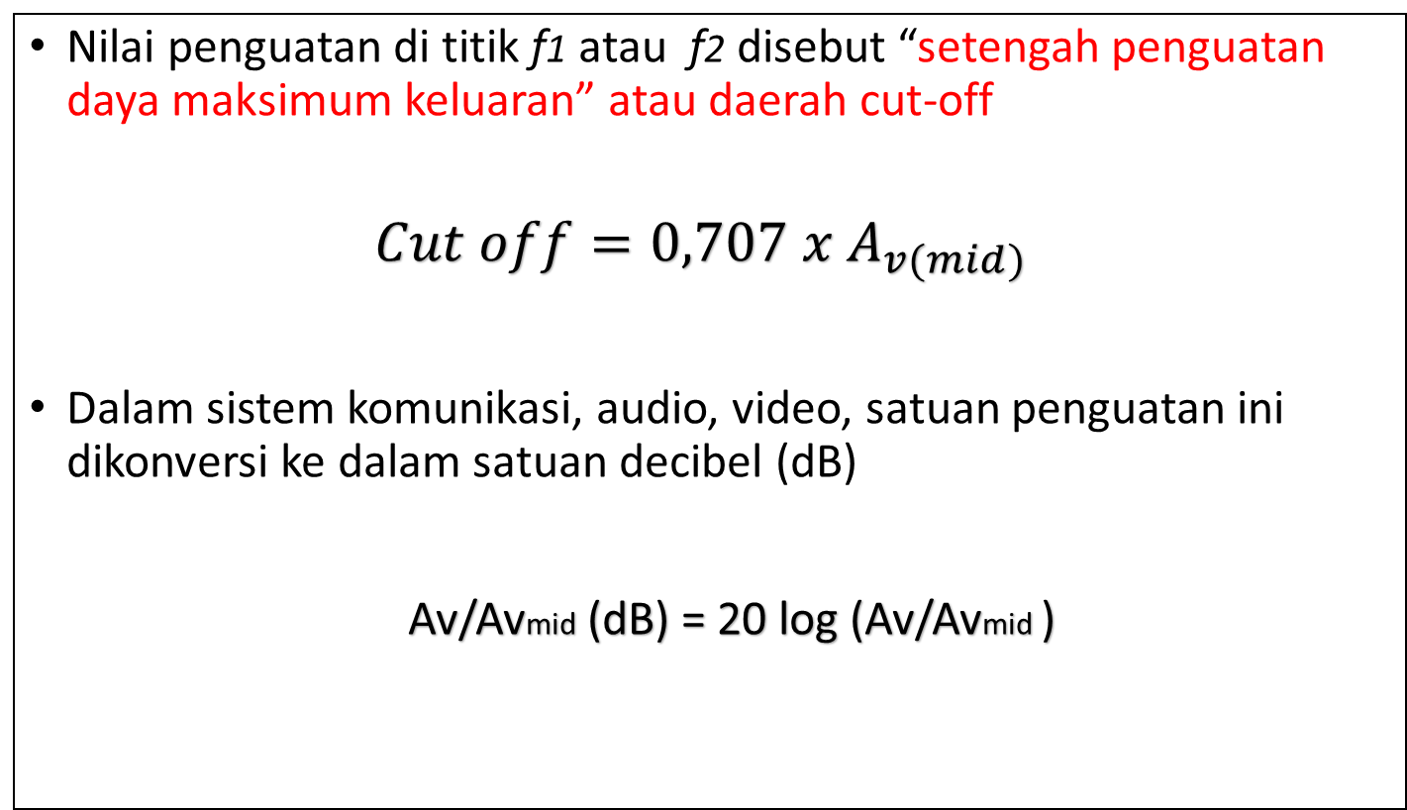
Nilai penguatan di titik f1 atau f2 disebut “setengah penguatan daya maksimum keluaran” atau daerah cut-off
$$Cut off=0,707 x A_{v(mid)}$$
Dalam sistem komunikasi, audio, video, satuan penguatan ini dikonversi ke dalam satuan decibel (dB)
Av/Avmid (dB) = 20 log (Av/Avmid )

Slide 34
Pengaruh Kapasitor pada Penguat
Kurva respon frekuensi menujukkan bahwa “antara kapasitor yang terpasang memiliki pengaruh berbeda terhadap hasil frekuensi cut off-nya”.

Slide 35
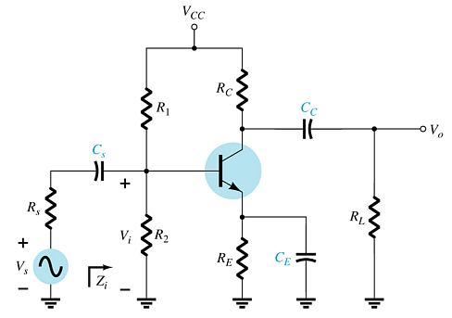

Slide 36
Respon penguatan di sisi frekuensi bawah
Sisi input (Cs)
Dimana:
hie = βre

Slide 37
Sisi ouput (Cc)
Dimana:

Slide 38
Sisi emiter (Ce: Capasitor bypass)
Dimana:

Slide 39
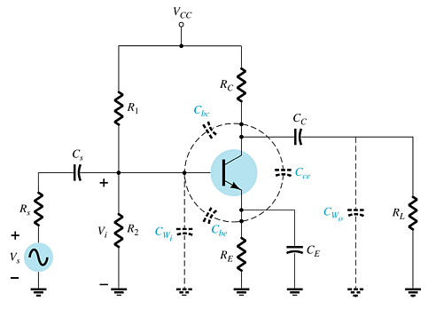
IV. Respon penguatan di sisi fekuensi atas
Pengaruh nilai kapasitansi terhadap respon frekuensi tinggi penguat BJT:
Kapasitansi Junction:
C_{be}, C_{bc}, C_{ce}
Jalur Kapasitansi :
C_{wi}, C_{wo}
Kopling Kapasitor :
C_{S}, C_{C}
Kapasitor Bypass :
C_{E}

Slide 40
Sisi input penguat
Dimana:
Nilai ini biasanya sudah ada di data sheet

Slide 41
Sisi ouput penguat :
Dimana:
Nilai ini biasanya sudah ada di data sheet

Slide 42
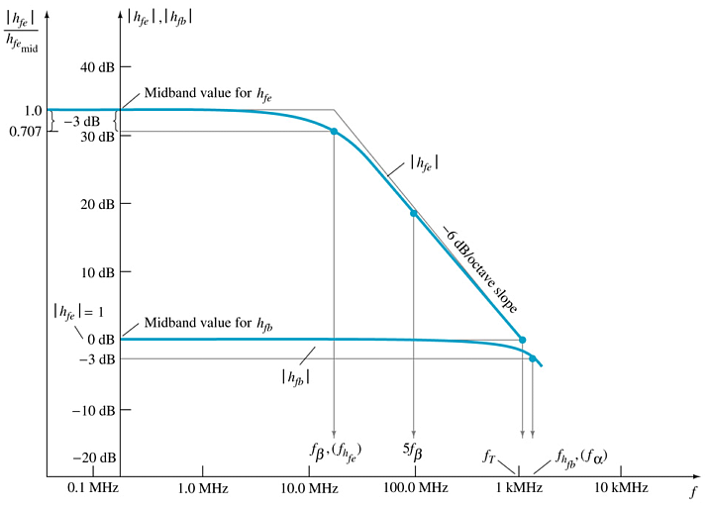
Efek Nilai h_{fe} (atau β)
Dampak variasi h_{fe} (atau β) sebuah transistor terhadap frekuensi kerja penguat :
dapat mempersempit atau memperlebar bandwidth penguat

Slide 43
HW
1. Perhatikan rangkaian penguat BJT berikut ini :
Jika diketahui parameter penguat sbb:
Tentukan respon penguatan pada frekuensi bawah di bagian :
sisi input-nya !
sisi output-nya !
sisi bypass-nya !

Slide 44
2. Simulasikan rangkaian penguat BJT berikut ini dan gambarkan kurva tanggapan frekuensinya

Slide 45
Thank You

